Slide 1
TEACHER PRACTICE: FOSTERING INTELLECTUAL ENGAGEMENT
Notes:
Talking Points:
Brief introductions of presenters (names, what school you teach at, what grade you teach)
Do Now: Sign into Today’s Meet and Padlet if you are using it.
Dual Projection: 1 with powerpoint, 1 with Today’s Meet
Make sure WiFi password is available.
Introduce binders and the contents.
Resources:
Instructions for Today’s Meet and Padlet
Activities:
Modifications:
Opportunity here to have team members introduce someone else instead of themselves

Slide 2
Introduction
Traffic Light Protocol
Rarely
Sometimes
Always
Think about yourself as a novice teacher.
Read each statement about teacher practice. Place a green, yellow or red dot to indicate the frequency with which you use this practice.
Notes:
Talking Points:
Use the discussion to bring out how and why they have increased their use of these points over the course of their career. By eliminating the second pass through with the dots we are hoping to save some time so it can be used for the tech discussions woven in. Have teachers note where they placed reds/yellows. The next three hours will give you ideas to improve that area.
Resources:
Instructions for traffic light protocol procedure
Activities:
Modifications:
1. Split room where one half posts dots with mindset of novice teacher and the other half with mindset of a veteran teacher. 2. Split chart into T chart so teachers can think about their own practice from both perspectives. 3. Ask teachers to stand where they put a green dot and share out why. Or stand where they put a red/yellow dot and shore out why.

Slide 3
Teacher Practices For Creating
Opportunities For Engagement
In an intellectually engaged classroom…
A consistent classroom management plan is employed.
“[Teachers] plan for classroom management. ...students practice procedures enough to execute them in a routine fashion.”
Marzano – Classroom Management
Plans include student learning activities.
“...a teacher’s role is not so much to teach as it is to arrange for learning. That is, a teacher’s essential responsibility is…to design (or select or adapt) learning activities such that students learn important content.”
Danielson – Planning
Notes:
Talking Points:
Debrief from the traffic light protocol. Use these quotes to support discussion. There are some key ideas in these quotes that reflect a certain mindset needed for “revisiting” how we approach instructional components. Each quote speaks to a topic of this intellectual engagement module as well as the engagement strategies of the traffic light protocol. Highlight keys words that stand out in each quote. Will come back to these during Key Takeaways.
Resources:
Activities:
Objective alignment quotes handout
Modifications:
Could bold out key words. In bold are some keywords that can probe our own thinking about what intellectual engagement is and the roles we play as teacher and student. As they come across the screen, and I read them aloud, jot down any immediate reaction to the keywords that so that you can reflect back upon completion of this module. Key words bolded for this option: 1. plan/routine 2. Important content/arrange for learning

Slide 4
Teacher Practices For Promoting Engagement
Higher order questions are asked.
“Teachers’ questions probe student thinking and serve to extend understanding.”
Danielson – Questions
Cooperative learning is used consistently and systematically
“Cooperative learning is a process. To support the success of cooperative learning, teachers must teach the steps of the process, provide students with opportunities to practice those steps, and clearly define the norms and parameters within which cooperative learning will take place.”
McRel – Cooperative Learning
Notes:
Talking Points:
The facilitator should continue reading the quotes while participants jot down immediate reactions to them
Resources:
Activities:
Objective alignment quotes handout (continued)
Modifications:

Slide 5
Teacher Practices For Enhancing Engagement
Technology is used to enhance learning.
“Teacher uses instructional technology to enhance student learning.”
Stronge – Technology
6. Reflection is a form of practice.
“Reflection can involve several cognitive activities that lead to stronger learning; retrieving knowledge and earlier training from memory, connecting these to new experiences, and visualizing and mentally rehearsing what you might do differently next time.”
Brown-- Make it Stick
Notes:
Talking Points:
The facilitator should continue reading the quotes while participants jot down immediate reactions to them
Resources:
Activities:
Objective alignment quotes handout (continued)
Modifications:

Slide 6
Why Intellectual Engagement?
Leading experts on teaching practice identify student engagement as core to learning.
Danielson | Marshall | Marzano | McREL | Stronge
3c | A.G C.G | DQ: 5 | Standard IV | Performance Standard 3
This crosswalk includes the most commonly selected (but not all) NJDOE- approved instruments.
Notes:
Talking Points:
Talk about validating the "facts" and linking the value of engagement is highly agreed upon. These models provide a framework, not a script/rules. Key focus is student engagement that creates a shift in the classroom dynamic.
Key Point- the evaluation frameworks guides the decision making for planning for engagement. Effective teachers ask HOW do I plan for intellectual engagement.
Resources:
Activities:
Modifications:

Slide 7
Why Intellectual Engagement?
Additionally, these frameworks all point to student-leadership in lessons as evidence of effective instruction throughout their domains.
Notes:
Talking Points:
Key Point- the evaluation frameworks guides the decision making for planning for engagement. Effective teachers ask HOW do I plan for intellectual engagement?
This slide has a clear point- how do we bridge the two?
student leadership = more engaged students. Teacher is the facilitator. The teacher is not the “Sage on the Stage”.
Trainer note: point out how several protocols will be woven throughout presentation and encourage participants to think about how they can adapt or utilize each protocol to foster intellectual engagement.
The rest of the presentation is how effective teachers create and make decisions that foster student leadership and student-centered classrooms.
Resources:
Activities:
Modifications:

Slide 8
Fostering Intellectual Engagement
Enhancing Student Engagement:
Reflection
T
E
C
H
N
O
L
O
G
Y
Core Engagement Strategies:
Questioning
Grouping
Develop an Intellectually Engaged Classroom Environment
Management
Planning
Notes:
Talking Points:
This is our framework. We really just need to talk about how classroom management is the foundation, grouping and questioning builds, and technology and reflection enhances. WIthout roots, your tree is falling over. The components of the tree are key aspects of student engagement that we will discuss - these elements will help us move our classroom to a more student- led classroom
Resources:
Activities:
Modifications:

Slide 9
Today’s Agenda
INTRODUCTION
FOUNDATION FOR ENGAGEMENT
CORE ENGAGEMENT STRATEGIES
ENHANCING ENGAGEMENT
9
Notes:
Talking Points:
Resources:
Activities:
Modifications:

Slide 10
Achievement Coach Program
This session is part of the New Jersey Achievement Coach Program.
Achievement Coaches are educators selected by their districts as leaders who share their knowledge of teaching and learning with their peers.
The three sessions led by Achievement Coaches were developed by New Jersey's educators to address specific needs.
Notes:
Talking Points:
This slide will not be discussed at ACSI. But point out content development by educators. New coaches will use this slide at their presentations to provide rationale for the program. Note it is teachers teaching teachers.
Resources:
Activities:
Modifications:

Slide 11
Norms
Active Listening and Learning
Listen hard, speak softly.
Take ownership over your learning.
Be solution-oriented.
Think about how this looks in your classroom or school.
Parking Lot
Please write any outstanding questions you have on the “Parking Lot” in the back of the room.
Cell Phones
Please keep phones on silent and take emergency calls/texts outside.
Notes:
Talking Points:
Also mention to take restroom breaks when you need to.
We have built in two 5-minute breaks.
Resources:
Activities:
Modifications:

Slide 12
Monitoring and Adjusting in the
Teaching and Learning Cycle
Fostering Intellectual Engagement
Using Assessment Data to Drive Instruction
Plan
Implement
Analyze
Collect
Effective Assessments
Notes:
Talking Points:
These three aspects of effective teaching work both cyclically and interdependently. They exist as a dynamic that drives how effective teachers impact students’ achievement through constant and active monitoring for success. Each module will provide key content for its topic. Consider the crossover of the content as part of the learning this week.
Resources:
Activities:
Modifications:

Slide 13
Session Objectives
Apply concepts from today’s presentation in planning concrete next steps towards…
developing a classroom environment which fosters an intellectually engaged class.
creating structures in which high quality questions and student discussions are a regular aspect of the classroom.
using instructional groups in the most effective and efficient manner.
utilizing technology to advance student engagement and learning.
using reflection as a tool to best support teaching and learning.
Notes:
Talking Points:
Read aloud or have audience members read aloud.
Resources:
Activities:
Modifications:

Slide 14
Technology to Support Engagement
As we discuss technology as a strategy to facilitate engagement, you are invited to contribute to an online discussion using:
Today’s Meet
Non-tech option:
Parking Lot with Post-its
Notes:
Talking Points:
At this point, teachers should be logged in to Today’s Meet.
ACKNOWLEDGE: that teachers may not have access to this technology during presentations, think about workarounds for them!
Be transparent with changes to presentation to integrate technology
Keep the group responses to questions accessible for all participants after the presentation ends for up to a year through Today’s Meet.
Resources:
There is also a sheet in resources with instructions for todays meet.
Activities:
Modifications:

Slide 15
Today’s Agenda
INTRODUCTION AND FRAMING
FOUNDATION FOR ENGAGEMENT
CORE ENGAGEMENT STRATEGIES
ENHANCING ENGAGEMENT
Notes:
Talking Points:
Resources:
Activities:
Modifications:

Slide 16
Fostering Intellectual Engagement
T
E
C
H
N
O
L
O
G
Y
Develop an Intellectually Engaged Classroom Environment
Management
Planning
Notes:
Talking Points:
Framing slide for progress of presentation
Resources:
Activities:
Modifications:

Slide 17
Classroom Management
Essential Question:
What does a classroom environment look like that engages students in their own learning?
Notes:
Talking Points:
Read aloud and keep the question in mind as we work through this segment. Question to keep in mind during next protocol
Resources:
Activities:
Modifications:

Slide 18
Classroom Management Activity
On separate post-its, write 3-5 classroom management strategies that you utilize.
Notes:
Talking Points:
Give an example of a strategy or two to prompt thinking – Teachers may be thinking of transition strategies, common classroom routines that save time, etc..
After participants have a few minutes to write, have participants share out a few of their strategies.
Resources:
Activities:
Modifications:

Slide 19
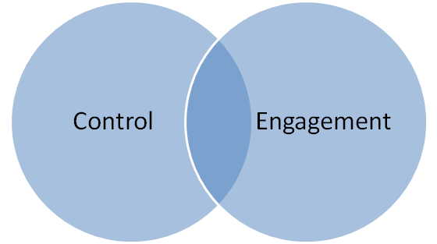
Classroom Management Activity
In your group, place the post-its on the Control/Engagement Venn Diagram.
Notes:
Talking Points:
Resources:
Venn Diagram in resources
Activities:
Use enlarged Venn Diagrams for this activity (will need 1 per group)
Modifications:

Slide 20
Classroom Management Activity
With your group, choose a strategy used for Control and discuss how it can be modified for greater Engagement.
Notes:
Talking Points:
Do a turn and talk.
Share out a strategy that you modified and moved.
The purpose is to shift the focus to engagement.
Point out that you need some control in order to facilitate the engagement.
Resources:
Activities:
Modifications:

Slide 21
Classroom Management Key Concepts
Effective teachers . . .
maximize instructional time.
ensure smooth transitions.
maintain momentum.
limit disruptions.
Notes:
Talking Points:
Read aloud
Key Note: Effective teachers aim to meet the above goals of management , ultimately with the goal of fostering intellectual engagement.
Resources:
Activities:
Modifications:
Tucker & Stronge, 2005

Slide 22
Planning
Essential Questions:
How can effective planning, establishing routines, and infusing technology support an intellectually engaged classroom?
Notes:
Talking Points:
Read aloud and keep the question in mind as we work through this segment. These slides setup for video activity
Resources:
Activities:
Modifications:

Slide 23
Fostering Intellectual Engagement
T
E
C
H
N
O
L
O
G
Y
Develop an Intellectually Engaged Classroom Environment
Management
Planning
Notes:
Talking Points:
Framing slide for progress of presentation
Resources:
Activities:
Modifications:

Slide 24
Planning Research
Effective teachers plan for intellectual engagement by identifying clear lesson and learning objectives, and carefully linking activities to them that engage students based on their needs.
Notes:
Talking Points:
Framing so when they watch the video, they watch with the lens of how what happens in the classroom can relate to their own classroom
Resources:
Activities:
Modifications:
Tucker and Stronge, 2005

Slide 25
Planning Activity
Grade One Reading
What is the teacher doing?
What are the students doing?
What else do you notice? (materials, resources, use of space and time, etc.)
Notes:
Talking Points:
Provide a brief introduction to the video.
Post viewing: emphasize the planning component, then move to share out time.
Be sure to share some modifications for different settings.
Resources:
This video is 3m52s.
Activities:
Chart is in the activity packet
Modifications:
Possibly add a high school/different content area video comparable to this that shows planning and routines

Slide 26
Planning Activity
Using your video guide, share what you noticed with a partner.
Share with whole group:
What evidence do you have that the students were engaged?
What did the teacher do to make this happen?
Notes:
Talking Points:
Add lists of ways these have been or could be adapted into different classrooms- share anecdotally.
Resources:
Activities:
Modifications:

Slide 27
Planning Activity
Notes:
Talking Points:
Focus is the student.
Resources:
Activities:
Modifications:

Slide 28
Planning Key Concepts
Lesson plans which foster intellectual engagement have:
clear student objectives.
organized content presentation that include student activities.
selected curriculum resources that reflect the objectives and student characteristics.
prepared questions to check for understanding and extend the learning opportunities.
Notes:
Talking Points:
Read aloud and emphasize that these decisions are made in the planning phase.
Tie back to video.
Resources:
Activities:
Modifications:

Slide 29
Planning Key Concepts
Effective lesson plans include the following:
Objective
Teacher activities
Student activities
Materials and resources
Assessment strategy
Planning & Management Interview
Notice, the educator used past assessment data to tailor her objectives, activities, and materials to meet the needs of her students. This is key to enhancing engagement.
Notes:
Talking Points:
Focus of this slide is to note that assessment drives planning.
Resources:
This video is 3m28s.
Activities:
Modifications:

Slide 30
Planning Application
Consider a recent lesson plan.
Identify routines and student activities which foster intellectual engagement.
What could you add to your lesson plan to foster greater intellectual engagement?
Notes:
Talking Points:
Jot down key activities and routines that foster greater intellectual engagement.
Add a way to foster greater engagement.
Brief turn and talk.
Make sure you bring it back to their teaching.
Resources:
Activities:
Modifications:

Slide 31
Reflection:
Management and Planning
Restate what you learned on Today’s Meet:
What role does each play when creating an intellectually engaged classroom?
Select one:
classroom management
planning
technology tools
Notes:
Talking Points:
Use Today’s Meet for this discussion. Have another presenter responding to comments on Today’s Meet.
Make sure to use these questions to help promote discussion in planning:
What is the difference between planning for my “to-do list” and planning for student engagement? What new meaning does planning and management take on when directly linked to intellectual engagement?
Presenter Note Only: The first word in every reflection is one of the 4 R’s of reflection which will be covered in the reflection portion of the slide.
Resources:
Instructions for Today’s Meet
Activities:
Modifications:
Could go through Today’s Meet and share some out. Could talk about using a tech tool could organize or pull out some thoughts.

Slide 32
Key Takeaways
Management
Routines allow for engagement as teacher and students must share ownership in maintaining control to maximize engagement
Technology may facilitate management strategies from control to engagement
Management is not limited to the environment inside the classroom
Planning
The planning phase begins the transformation from teacher-led to student-led classrooms
Planning for intellectual engagement establishes teachers as facilitators of student learning
Effective teachers recognize the various needs of their students and plan for engagement based on those needs.
Notes:
Animation Notes: Management and 3 bullets fade in first, then planning and 3 bullets fade in second
Talking Points:
Return to the key phrases underlined of the first two quotes during our post-discussion of the traffic light protocol. Consider your reactions to the keywords in light of our learning so far: As you start to form your own takeaways, ask yourself: How are your own definitions of planning and classroom management beginning to deepen or change?
These takeaways will be provided- presenter will choose one from Management and Planning that really resonates with them to share.
Resources:
Activities:
Return to Objective alignment quotes handout
Modifications:
Presenters may ask teachers to write one takeaway for each topic before sharing the whole slide.
Could have participants pick one that resonates with them
5 Minute Break here.

Slide 33
Today’s Agenda
INTRODUCTION AND FRAMING
FOUNDATION FOR ENGAGEMENT
CORE ENGAGEMENT STRATEGIES
ENHANCING ENGAGEMENT
Notes:
Talking Points:
Resources:
Activities:
Modifications:

Slide 34
Fostering Intellectual Engagement
T
E
C
H
N
O
L
O
G
Y
Core Engagement Strategies:
Questioning
Develop an Intellectually Engaged Classroom Environment
Management
Planning
Notes:
Talking Points:
Framing slide for progress of presentation
Resources:
Activities:
Modifications:

Slide 35
Questions
Essential Question:
How can high quality questions
create a high quality
opportunity for learning?
Notes:
Talking Points:
Read aloud and keep the question in mind as we work through this segment.
Resources:
Activities:
Modifications:

Slide 36
Questions Research
How do high quality questions promote learning?
Stimulate thinking
Clarify understanding
Reveal misconceptions
Deepen understanding
Hear alternate views
Make connections
Notes:
Talking Points:
Stimulate thinking
At all levels of cognitive ability.
High quality is not simply limited to “higher order” only.
Clarify Understanding
Promotes students’ abilities to demonstrate their level of content understanding.
Enables to teacher to set learning goals and objectives.
Reveal Misconceptions
Identifies gaps.
Provide opportunities for “teachable moments.”
Deepen Understanding
Especially when a variety of cognitive rigor is employed.
Hear Alternate Views
Extends thinking.
Make Connections
Previous learning to new material to promote skill transfer.
Between disciplines.
Classroom to real world.
Resources:
Activities:
Modifications:
https://www.learner.org/workshops/socialstudies/pdf/session6/6.ClassroomQuestioning.pdf

Slide 37
Questions Activity
On separate Post-its, write 5 to 7 questions that you hear in the video.
Questions
Notes:
Talking Points:
We are now going to watch a questioning montage video.
Please have a pen and your post-it’s ready.
Resources:
Video: 4 minutes, 19 seconds
Activities:
Modifications:

Slide 38
Questions Activity
Affinity Protocol:
With your group, place all of your Post-its on the wall.
Sort all of the questions that you collected by only moving your Post-its. (No talking!)
Share how you sorted them in your group.
Share out with whole group.
Notes:
Talking Points:
Affinity Protocol: (Groups of 4-5)
Can be done at tables.
If there is space, use walls or Post-it chart paper to facilitate.
Remind groups of time and “Silence” during sorting. Be sure to call time so audience knows when it is okay to start talking for next step of protocol.
Provide groups time to share sorting methods in groups first.
Share out with whole group.
Resources:
Activities:
Modifications:

Slide 39
Questions Activity
Possible ways to categorize questions
Low level/high level
Open/closed
Teacher/student
Divergent/convergent
Google/good
Notes:
Talking Points:
Teaching point (facilitator led) – Facilitator will identify where these areas have already been identified through the sorting process, and also point out other ways to think about questions that haven’t been identified.
Discuss each type.
Resources:
Activities:
Modifications:

Slide 40
Questions Key Concepts
Questions need to be purposeful.
Intellectual engagement requires a mix of questions, beginning with lower level, teacher-created, convergent, Google-type questions for management and assessment . . .
Notes:
Talking Points:
Info on both slides are important.
Neither lower level or higher level questions are necessarily better than the other especially when scaffolding instruction.
Variety based on purposeful develop of questions for “Management, Assessment, Engagement, and Learning.”
Questions are purposeful when...question achieves your desired purpose or learning outcome.
Engages student in the instructional process through the varied context of questioning.
Resources:
Activities:
Modifications:

Slide 41
Questions Key Concepts
. . . and leading towards open ended, higher-order, divergent questions which cause engagement and learning because they require discussion, research, and evidence to support the answer.
Notes:
Talking Points:
Evidence are the demonstrable requirements of higher-order and higher level questioning.
Need a mix of all types of questions.
Resources:
Activities:
Modifications:

Slide 42
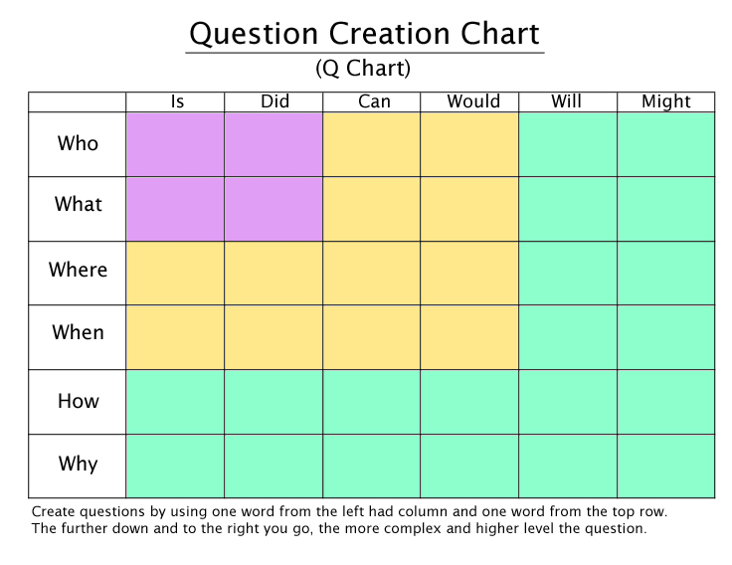
Questions Activity
Notes:
Talking Points:
Great way to start adding variety of lower and higher order level questions.
Simplistic and easy to use.
Ask: How could you use this in your classroom?
Sample questions: How would you edit the sample claim?
Why might Victor Frankenstein not be capable of redemption?
What is the number of minutes you need to complete the activity?
Resources:
Make sure this handout is printed in color
Activities:
Modifications:

Slide 43
Questions Activity
Write three questions using the chart, and identify the purpose of the question.
Management
Assessment
Engagement & Learning
Notes:
Talking Points:
Done on Padlet.
Ask a few participants to share responses and identify the purpose.
Ask: How could you use Padlet in your classroom?
Resources:
Padlet screenshot should be showing on second projector.
Activities:
Modifications:

Slide 44
Questions Activity
Examples of questions with different purposes:
Management
How do we move into groups?
Who is the time-keeper?
Who gathers the painting supplies for this week’s project?
Assessment
What is the capital of China?
Who is the main character?
When would photosynthesis occur?
How many players can be on the court during a volleyball game?
Notes:
Animation Notes:We would like the animation to have the questions come in by type as opposed to individually.
Talking Points:
Resources:
Activities:
Modifications:

Slide 45
Questions Activity
Examples of questions with different purposes:
Cause engagement & learning
Where did we use this concept before?
How might this impact the future?
Why do you multiply by the reciprocal when dividing fractions?
How will you support your thesis statement?
How might you modify your rocket design to increase distance traveled?
Why might you choose a current arrangement of a musical piece as opposed to an original composition?
Notes:
Talking Points:
Need all 3 types of questions, but try to incorporate as many as you can that cause engagement and learning.
Resources:
Activities:
Modifications:

Slide 46
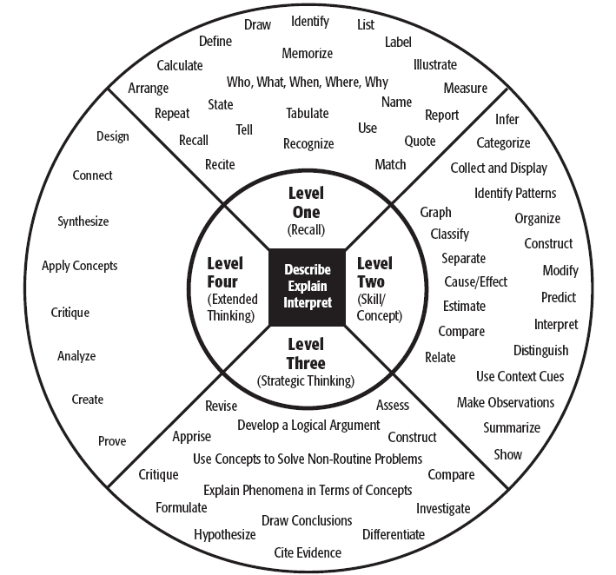
Depth of Knowledge and Questioning
Webb's Depth of Knowledge Guide
Notes:
Talking Points:
Inner circle of DOK identifies the various level of student engagement at each level of cognitive
complexity.
Each level identifies how deeply students have to understand the content to successfully interact with it.
Level 1-Recall/reproduction-one correct response
Level 2-Apply skills/basic concepts-may not exactly have one correct response.
Level 3-Strategic thinking, reasoning-does not have one correct response
Level 4-Extended thinking and time to do the research and consider the multiple, complex tasks to complete it.
In other words, the common theme of aligning questions within an appropriate DOK level is determining what the question requires students to do or demonstrate about their knowledge to answer it at the appropriate DOK level?
Resources: Additional DOK resource:
http://4.bp.blogspot.com/-FUR5k7Ubxh8/UfMLD0hkeHI/AAAAAAAABJw/s86CjsTTJfo/s640/DOK.png
http://1.bp.blogspot.com/-UPZPwFgLVfc/UoOuPWPN9nI/AAAAAAAABOw/jSDd3vbe_fk/s640/DOK+Flow+Chart.001.jpg
Math: http://storage.cloversites.com/teachforamericacolorado/documents/DOK%20Mathematics.pdf
Writing: http://www.rgccisd.org/training%202013%2014/Tri-Lin/DOK%20Levels%20Writing.pdf
Science: http://www.nciea.org/publications/DOKscience_KH11.pdf
Social Studies:http://www.rgccisd.org/training%202013%2014/Tri-Lin/DOK%20Levels%20Social%20Studies.pdf
Reading: http://www.nciea.org/publications/DOKreading_KH08.pdf
Activities:
Modifications:
Content update: Explaining DOK here to stress appropriate ranges of rigor when employing questions.
Possibly: Have participants briefly examine resources and they will see this common aspect in each of the resources above.

Slide 47
The Basics of Webb’s DOK
Used to determine level of rigor based on cognitive complexity:
Considers “complexity” versus “difficulty” of task or question.
Identifies thinking level required to produce acceptable responses.
What cognitive processes are demanded by the task/question as outlined by the objective of the task/question?
Does the DOK level of question match the complexity of the response?
In other words, are the students engaging at the required DOK level of questioning?
Notes:
Talking Points:
Complexity vs. difficulty
Difficulty:
How Much Effort is needed to answer a question, solve a problem, or complete a task.
Defined as easy or hard based on how many people can answer the question correctly or successfully.
Complexity:
What type of thinking, action, or knowledge must be demonstrated and communicated to answer a question, solve a problem, or complete a task and how many different ways are there to do this.
How many different ways can the question be answered or the task accomplished.
Alignment of level: Other points addressed here:
DOK level helps teachers as well as students recognize students’ levels of engagement as well as assess whether the level of engagement is aligned to questions posed. Webb’s DOK is also a great tool to use to promote a more stair-cased approach to question design and developmental expectations across grade levels within a discipline.
Scenario 1:
Teacher asks primarily level 1 questions, and many students participate. Yes, it seems the teacher had a lot of participation, but only at a low level of rigor.
Scenario 2:
Teacher asks a range of questions and levels of participation vary due to the complexity of some questions and students may struggle through, but they do so at a more varied range of rigor.
Scenario 3:
Teacher asks students questions that require extended thinking, but student response only provide responses based on recall. Here, student’s response does not meet the demands set forth by the questions to produce an acceptable response. Teacher engages students in a teachable moment to help them understand the specific demands of various levels of thinking required by the question’s level of rigor.
Resources:
Add handouts from resource on Webb’s that provides list of student roles/ teacher roles/behaviors/activities.
DOK question stems for evel level and different content areas.
Talking Points taken from HOT/DOK: http://maverikeducation.blogspot.com/2014/03/difficulty-vs-complexity-whats.htm
Activities:
Modifications:

Slide 48
Depth of Knowledge and Questioning
Level One
Level Two
Level Three
Level Four
Who fought in the Civil War?
How were Union soldiers similar to Confederate soldiers?
What evidence supports the South having the right to secede from the United States?
What do you feel the long term impact of the Civil War will be on the United States?
Notes:
Talking Points:
DOK is about depth and complexity.
The intended student learning outcome determines the DOK level.
Whereas Bloom identified the “type” of thinking needed to complete a task, Webb’s Depth of Knowledge identifies how deeply students have to understand the content to successfully interact with it.
In other words, how complex or abstract is the content. Therefore, what comes after the verb in the question is the best indicator of rigor and the DOK Level.
Stress here the importance of the appropriate level of rigor. Kids need to be able to identify before they can apply.
Want to add a DOK question stem handout.
In each question above, consider what the student has to do to answer these questions at the appropriate DOK level of rigor.
Resources: https://education.ohio.gov/getattachment/Topics/Teaching/Educator-Evaluation-System/How-to-Design-and-Select-Quality-Assessments/DOK-Question-Stems.pdf.aspx
Activities:
Modifications:

Slide 49
Reflection: Questions
Remember and relate to your experience on Today’s Meet:
Recalling a previous lesson, how can you enhance your questioning techniques to foster intellectual engagement?
Notes:
Talking Points:
Resources:
Activities:
Modifications:
Note the first word in every reflection is one of the 4 R’s of reflection which will be covered in the reflection portion of the slide.

Slide 50
Fostering Intellectual Engagement
T
E
C
H
N
O
L
O
G
Y
Core Engagement Strategies:
Questioning
Grouping
Develop an Intellectually Engaged Classroom Environment
Management
Planning
Notes:
Talking Points:
Framing slide for progress of presentation
Resources:
Activities:
Modifications:

Slide 51
Instructional Groups
Essential Question:
How can using appropriate instructional groups support intellectual engagement and facilitate student-centered discussion?
Notes:
Talking Points:
Read aloud and keep the question in mind as we work through this segment.
Resources:
Activities:
Modifications:

Slide 52
Instructional Groups Research
Working with a small group provides “high quality,” intensive instruction appropriate for every member of the group. (Fountas and Pinnell, 2001)
Teachers challenge all learners by providing instruction at varied levels of difficulty based on needs by using instructional groups. (Tomlinson, 2000)
Cooperative group work results in increased self esteem, improved relationships among students, and increased social and educational skills. (Gillies, 2008)
The most powerful single modification that enhances achievement is feedback through small group instruction. (Hattie, 1992)
By intentionally incorporating the elements of positive interdependence and individual accountability, teachers set the stage for students to be responsible for their own learning; the learning of those in their group; and the ability to demonstrate what they know, understand, and are able to do.(McRel, 2012)
Notes:
Talking Points:
These quotes all show the importance of using instructional groups.
Resources:
These quotes are in the activity packet.
Activities:
VIP Word or Phrase protocol: ask audience to read the 5 statements and underline or highlight VIP word or phrase. After about a minute, when individuals share out what they underlined, the“I had that” protocol can be done: after a person shares the VIP word/phrase, audience members who had the same can shout “I had that”..
Modifications:

Slide 53
Plickers
Plickers is a free tech tool that we will use to foster critical thinking about engagement. You need to create an account online and get the app on a mobile device.
Rotate your Plicker symbol to indicate a response to 3 questions: A, B, C, or D.
Notes:
Talking Points:
This question shows the amount of time students participate in a lecture style class. (36 seconds in a 1 hour class with 30 students)
Key Point: Importance of instructional groups.
Ask: How could you use Plickers in your classroom.
Resources:
Directions / How to
Activities:
Cook, 2000, Charleston, 1989 Tech: Plickers
*Limit to 15 - people can partner up.*
Modifications:

Slide 54
Instructional Groups Activity
Instructional Groups
What is the teacher doing?
What are the students doing?
What else do you notice? (materials, resources, use of space and time, etc.)
Notes:
Talking Points:
Resources:
Handout (copy for training session) this will facilitate first round of silent discussion
Activities:
Watch Video= 5 minutes
Modifications:
Instead of having individuals write notes on this graphic organizer while watching the video, then transferring them to chart paper, have participants take notes right on chart paper to save time.

Slide 55
Instructional Groups Activity
After watching the videos and taking notes, what characteristics were necessary for the groups to work?
Use Silent Discussion Protocol to share with your group. Use words, pictures, or phrases to write one thing you noticed on the chart paper. When prompted, turn chart paper, read and write more. Continue until you are back to your initial comment.
Notes:
Talking Points:
Discuss how this can be done in the classroom. Focus on low risk, for students who are reluctant to share in class
Resources:
Directions- written explanation for protocol
Activities:
Best if completed in separate location (floor, table)
Groups of 4 are ideal
Each group share out their big findings
Write 1 phrase in the middle that encompasses all notes
Modifications:

Slide 56
Instructional Groups Activity
Planning for Groups
Visible characteristics for success
Invisible characteristics for success
Notes:
Talking Points:
Have them write in the slides handout visible and invisible characteristics they see.
Share out
Resources:
This video is 3m45s.
Activities:
Modifications:
Could use Stand Up, Hand Up Protocol, but easy to cut to save time.

Slide 57
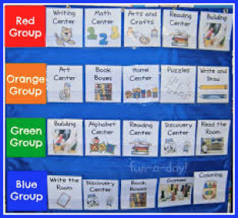
Instructional Groups Key Concepts
Visible characteristics for success
Defined meeting space
Organized and available materials
Routines established
Notes:
Animation Note: Have 3 bullets come in second
Talking Points:
Have audience share before you reveal.
Read aloud
Resources:
Activities:
Modifications:

Slide 58
Instructional Groups Key Concepts
Invisible characteristics for success
data used in planning
used at appropriate times in unit
used often enough, but not every day
self-assessment or teacher assessment is included
Notes:
Animation Note: Have 4 bullets come in second.
Talking Points:
Have audience share some, then reveal
Read aloud
Resources:
Activities:
Modifications:

Slide 59
Instructional Groups Key Concepts
Grouping patterns
Turn and talk (random)
Turn and talk (partners chosen by teacher)
Small groups (low structure)
Differentiated groups – assessment/data based
Notes:
Talking Points:
Read aloud.
Point out resources.
Resources:
Included possible ways to find partners (clock, phone, NSEW)
Included possible group role cards.
Activities:
Modifications:

Slide 60
Student-Centered Discussion
"I never teach my pupils; I only attempt to provide the conditions in which they can learn." -- Albert Einstein
Learning is an interactive process between the student, the teacher, and the subject matter. Learning is enabled by a teaching approach. A well thought out teaching approach serves to motivate students’ desire to learn, empowers students to think about the subject matter on their own, and helps the teacher create a learning environment that is developmentally appropriate. Such a teaching approach enables students and the teacher to take part in the learning process as co-thinkers.
Highlight or underline 5 key words or phrases from the quote.
With a partner, volley back and forth sharing a key word or phrase.
http://www.interactivityfoundation.org/wp-content/uploads/2009/12/Guidebook-for-Student-Centered-Classroom-Discussions.pdf
Notes:
Talking Points:
Read the quote. Highlight and underline 5 keys words/phrases. Volley share with partner. Come up with a key takeaway.
Share out key takeaways. Possible answers: students take over, teacher is a facilitator, all co-thinkers.
Resources:
Activities:
This quote is in the Activity packet for them to highlight.
Modifications:

Slide 61
Teacher Led vs. Student Led
Discussion
 | Teacher Led Discussion | Student Centered Discussions
Discussion Interaction | Teacher to Student | Student to Student
Role of Teacher | Control Discussion Flow Serves as Expert | Assess Student Discussion Mentor Students
Content Understanding | Externally Driven by Teacher | Internally Driven by Students
Teacher Role | Content Expert | Student Development Mentor
Student Role | Listening Note Taking | Discussing Developing
Copyright 2008. Interactivity Foundation (all rights reserved).
Notes:
Talking Points:
Explain that the chart is showing hows roles change from a teacher led to student led. Roles being taken over by the student.
Read one aloud as an example and explain that the rest follow the same trend of turning the learning over to the students.
How does it speak to levels of student engagement based on observable differences between the two?
Use as lead into to “fish bowl” practice.
Resources:
Show sample lesson plan here with questions (it’s an example of a student-centered discussion)
Activities:
Modifications:
This can also be used to introduce roles plays during fish bowl.
Assessor-evaluate/provide feedback
Mentor/Coach-helps others to engage/articulate ideas
Facilitator-Drives process
Students will naturally play these various roles based on how they respond and participate in the discussion.

Slide 62
Student-Centered Discussion
Fishbowl- Do Now:
Read the handout, “Keys to Effective Student-Centered Discussion” highlighting and annotating addressing the fishbowl questions in preparation for today’s fishbowl:
What are the keys to effective student-centered discussion?
Which component do you feel is most crucial for success?
Notes:
Talking Points:
How to facilitate a discussion led by the students.
Have all the participants read the article and highlight and annotate as you go. Be prepared to answer the 2 questions.
Resources:
Have role cards on the table.
Activities:
“Keys to Effective Student-Centered Discussion” is in activity packet.
Modifications:

Slide 63
Fishbowl Protocol
Inside circle: Four “fish” in a bowl
Will assume the roles of facilitator, time-keeper, presenter, and encourager.
Outside Circle: Observers are listening in on the conversation - not carrying on their own conversation
Consider the discussion questions, but feel free to take the discussion where you want to go!
Notes:
Talking Points:
The Teacher is an Observer!
Resources:
Link to a video of a fishbowl
https://drive.google.com/file/d/0B8_Hm7zmAbJSM0wxcVl3MmotTDA/view
Activities:
After reading the article, assign 4 people to become the inner circle.
You can prepare this ahead of time and place 4 stickers in 4 of the folders and whoever has a sticker becomes the inner circle.
Place 4 different colored stickers. Assign roles based on the color sticker.
Assign roles to the inner circle based on the color sticker they have in their folder. Role cards are given. (could be worn as necklaces)
After the discussion, have presenter share big findings and outer circle share aloud and react.
Modifications:
Variations could include: outside circle being able to tap in and participate, outside and inside circle switching roles, assign outside circle a particular role to observe and react to.

Slide 64
Reflection:
Student-Centered Discussion
React with your opinion via Today’s Meet:
What instructional grouping tools/protocols will work to enhance student-led discussions in your classroom?
Notes:
Talking Points:
Resources:
Activities:
Modifications:

Slide 65
Key Takeaways
Questions
The purposes of questions are to design ways to engage students in the instructional process.
Teachers need to determine how students will demonstrate engagement at the appropriate DOK level of rigor.
Teachers need to scaffold questioning to achieve their desired learning outcomes.
Groups
Planning for groups involves a mix of visible and invisible characteristics to ensure effectiveness.
Group roles need to be well defined, practiced, and expectations need promote intrinsic and extrinsic accountability.
Well-designed student-led discussion allows students to assume the roles of mentor, coach, and facilitator.
Notes:
Animation Notes: Questions and 3 bullets fade in first, then Groups and 3 bullets fade in second
Talking Points:
Return to the key phrases underlined of the second two quotes during our post-discussion of the traffic light protocol. Consider your reactions to the keywords in light of our learning so far: As you start to form your own takeaways, ask yourself: How are your own definitions of questions and grouping beginning to deepen or change?
These takeaways will be provided- presenter will choose one from Questions and one from Groups that really resonates with them to share.
5 Minute Break here
Resources:
Activities:
Return to Objective alignment quotes handout
Modifications:
Presenters may ask teachers to write one takeaway for each topic before sharing the whole slide.

Slide 66
Today’s Agenda
INTRODUCTION
FOUNDATION FOR ENGAGEMENT
CORE ENGAGEMENT STRATEGIES
ENHANCING ENGAGEMENT
Notes:
Talking Points:
“Pedagogy should at its best be about what teachers do that not only help students to learn but actively strengthens their capacity to learn.”
David Hargreaves, Learning for Life, 2004, p 27
Resources:
Activities:
Modifications:

Slide 67
Fostering Intellectual Engagement
Enhancing Student Engagement:
Reflection
T
E
C
H
N
O
L
O
G
Y
Core Engagement Strategies:
Questioning
Grouping
Develop an Intellectually Engaged Classroom Environment
Management
Planning
Notes:
Talking Points:
Framing slide for progress of presentation
Resources:
Activities:
Modifications:

Slide 68
Reflection
Essential Question:
What role does reflection play in the learning process?
Notes:
Talking Points:
Read aloud and keep the question in mind as we work through this segment.
Reflection is part of the learning process for learners of all ages - students and teachers alike. For this portion of the module, we are focusing on students’ reflection.
Resources:
Activities:
Modifications:

Slide 69
Reflection Research
Reflection makes learners ponder and think recursively.
4 R’s of Reflecting:
Restate - what did you learn
React - what is your opinion
Remember - relate to your experience
Respond - with a question
Notes:
Talking Points:
Facilitating reflection tasks after students have had some practice with a concept or skill allow for them to complete a task that is metacognitive in nature.
The tasks will involve at least one of the 4 R’s.
If you remember back to today’s reflections within the module, you will hopefully recall that every reflection tasks involved at least one of the 4 R’s. Point out to participants that they have been doing this all along.
Resources:
Activities:
Modifications:

Slide 70
Reflection Key Concepts
Reflection is:
a recursive revisiting of what was learned.
an opportunity to examine what was learned from a new perspective or to add another layer to what was learned.
an invitation for learners to think critically or metacognitively.
often what “cements” or clarifies learning.
Notes:
Talking Points:
Learning is NOT filling a bucket with knowledge
Instead, learners ideally intrinsically own their growth
Reflective tasks hold the learner accountable for his/her learning which, in turn, promotes ownership of one’s learning.
Resources:
Activities:
Modifications:

Slide 71
Fostering Intellectual Engagement
Enhancing Student Engagement:
Reflection
T
E
C
H
N
O
L
O
G
Y
Core Engagement Strategies:
Questioning
Grouping
Develop an Intellectually Engaged Classroom Environment
Management
Planning
Notes:
Talking Points:
Framing slide for progress of presentation.
Resources:
Activities:
Modifications:

Slide 72
Technology
Essential Question:
Specifically how does technology enhance the learning process?
Notes:
Talking Points:
Read aloud and keep the question in mind as we work through this segment.
Resources:
Activities:
Modifications:

Slide 73
Reasons for Technology Integration
Promote Collaboration
Foster
Creativity
The Four C’s of 21st Century Learning
Encourage Critical Thinking
Facilitate Communication
What is the relationship between technology in the classroom and “the four C’s” of 21st century learning?
Notes:
Talking Points:
Emphasize that the reality of our student’s world is that they communicate and learn with technology. This extends their learning beyond the classroom. This is their way of life, so we are meeting them at their level. This visual answers the questions. Pieces all work together.
Resources:
Activities:
Modifications:
Consider laminating a poster with 4 c’s for presentation rooms by DOE and as a give-away prize.

Slide 74
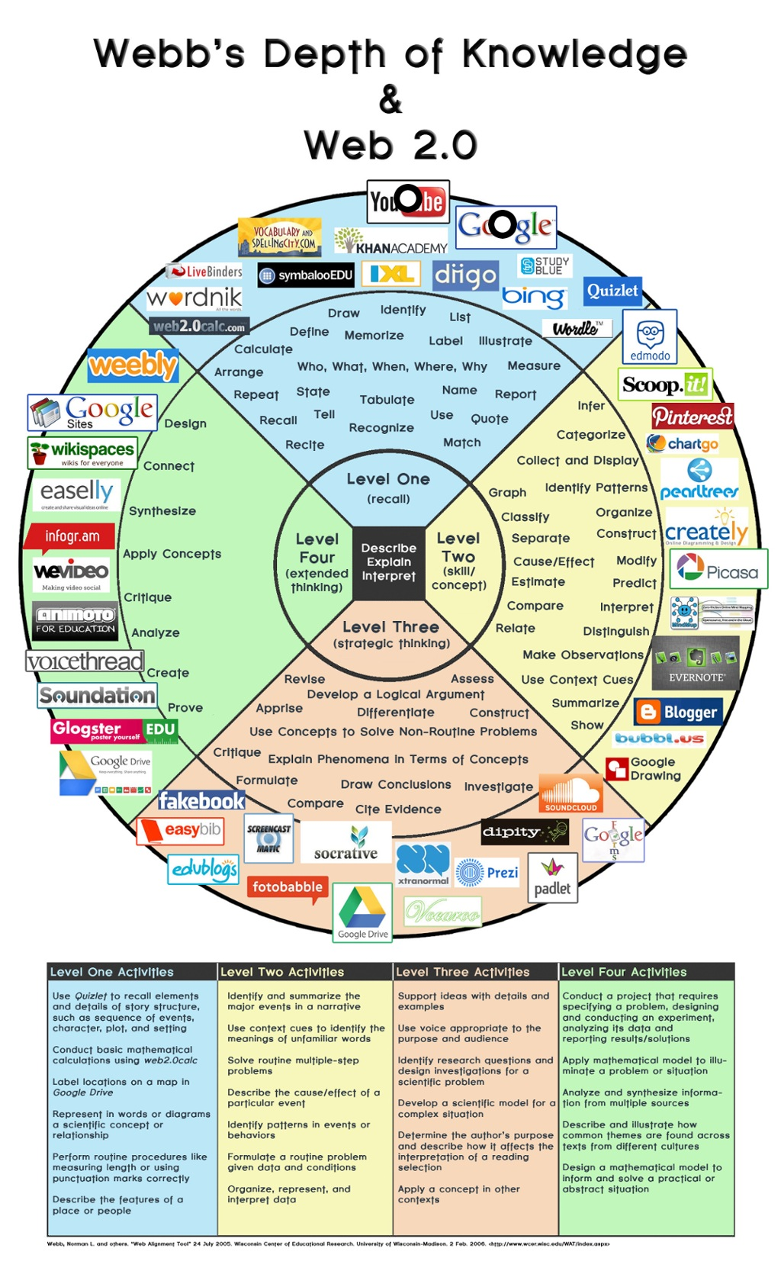
Depth of Knowledge and Technology
Webb’s Depth of Knowledge
&
Web 2.0
Notes:
Talking Points:
Make sure the audience understands that the growth of questioning for students was married to the tech that can assist in this process.
Ask: How could you pair technology with reflection?
Resources:
This is included in the resource packet.
Activities:
Modifications:

Slide 75
Post-it Protocol
Write each tech tool in your current repertoire on a Post-it
Collate your Post-its with the whole group
Sort and label using the 4 C’s
Use “Epic BYOD Toolchest” as a reference
Notes:
Talking Points:
After post-its are sorted, share out 1 from each. Might have been discussion about where to place them. Can often cross sections. That shows how they are all connected.
Resources:
Please note: Included in the references is a BYOD Toolchest for school districts. This is a checklist that outlines the technical considerations you may need to address before presenting in a district.
Activities:
Picture for Edutopia is hyperlinked. This site include several technology resources that are school appropriate.
Modifications:

Slide 76
Technology for Intellectual Engagement
Watch this Video
Using Technology to Increase Intellectual Engagement
-Clearview Regional Media Production
What resonates with you?
Notes:
Talking Points:
Share out in groups of 3
Resources:
Video: 2m 19 sec
Activities:
Modifications:
Wow and Wonder Protocol

Slide 77
Technology Key Concepts
Technology in the classroom supports engagement, assessment, and differentiation.
(Examples: Today’s Meet, Socrative, Google Forms)
Technology outside the classroom supports on-going learning.
(Examples: Google Docs, Online classrooms such as Moodle, Google Classroom and Canvas, Edmodo, Weebly, Twitter, YouTube, Instagram)
Use what is permitted as there is plenty to choose from.
(Examples: Plickers, Kahoot, Remind, Padlet)
Notes:
Talking Points:
It is more important to highlight these items after they have been used as part of the actual presentation with teachers. Ultimately, teachers will then not only become familiar with these some of these tools, but will see how to more seamlessly integrate them into their own classrooms. We are thinking a flag in the presentation, or cards with the actual tools listed, may be a good way for teachers to gather these platforms for their own toolkits. We will have an appendix tab in their binders for the “how-tos” of setting up any technology we use throughout the presentation. Then a good activity may be to have them bring any additional tool they want to contribute.
Resources:
Activities:
Modifications:

Slide 78
Reflection: Technology Success Story
Remember and relate via Today’s Meet:
Share an experience when a tech tool facilitated one of the 4 C’s.
Include:
Grade level
Tech tool
Lesson objective
The “C” factor (Collaboration, Communication, Creativity, or Critical Thinking)
Notes:
Talking Points:
Resources:
Activities:
Modifications:

Slide 79
Key Takeaway Strategies
Key Takeaways
Technology
Technology provides a platform for continuous learning and reflection.
Technology fosters collaboration among teachers and students.
Technology resources align with a variety of learning styles that can guide planning for instruction and assessment.
Reflection
Reflection can deepen students’ engagement and help internalize the learning.
Reflection can be a pathway to setting learning goals.
Reflection promotes self-evaluation for students and teachers.
Notes:
Talking Points:
Kahoot (good for reflection, data and feedback!)
Anything Google!
Useful to list a few cheap subscription things here that are subject specific ideas crossing multiple grade levels. ex.MobyMax
Useful to group by type….multiple choice, build own questions, open ended, complies responses, etc.
Should be supplemental to presentation tools
Post-It Activity
giving a tip to the next class period or next year’s class about that day’s lesson.
Assessment Reflection
Identify what’s wrong
Why is it incorrect?
How can you fix it?
Learner Reflection
What type of learner are you?
Activity to help identify
have activities for multiple grade levels
Resources:
Activities:
Modifications:

Slide 80
Get ready to...
Disco-flect!
Notes:
Talking Points:
Split participants into two groups. One suggestion is to have them count off by A and B. Have the two groups stand in two lines facing each other. When the music plays the first three participants from line A and the last three participants from line B dance down the middle (like in Soul Train). A counter-motion of the lines is needed so participants have a different partner each time. When the music stops the person across from you is your reflection partner. A question is asked and you have about a minute to discuss. Music starts and the process repeats. You will advance through the slides of this section using this procedure.
Resources:
Please note - you will need to have a song ready to go -it is not included in this slide deck!
Activities:
Modifications:

Slide 81
What’s your big takeaway from DOK?
Notes:
Talking Points:
Resources:
Activities:
Modifications:

Slide 82
Which technology resource will you
use in your classroom?
Notes:
Talking Points:
Encourage participants to commit to investigating at least one!
Resources:
Activities:
Modifications:

Slide 83
What is one protocol that you will use in your classroom? Why and how?
Traffic light
Post-it
Affinity
Silent Discussion
Fishbowl
Wow and Wonder
VIP Word/Phrase
“I had that”
Volley share out
Notes:
Talking Points:
Participants will reflect on a tool for engagement they can immediately take away.
Resources:
Activities:
Modifications:

Slide 84
Boogie on back...
Homework for the break:
Share on social media about your enthusiasm!
#ACSI2016
Notes:
Talking Points:
This transitions participants back to their seats. Tell participants to think of the protocol from the last slide and when the music starts dance back to their seat. They are ready to complete the homework.
Resources:
Activities:
Modifications:

Slide 85
Module Closure
Respond to the module with a question on a Post-it as an exit ticket:
Consider your turnkey presentation of this module in your district. Write a related question you want to see addressed in Part 2: Preparing to Turnkey the Module.
Notes:
Talking Points:
*For ACSI only, not for turn keying to districts.
Resources:
These 3 video are good examples of Intellectually Engaged Classrooms. Consider showing them in summary to your districts depending on grade-level.
Grade 7 Science
Grade 3 Social Studies
Grade 11 History
Activities:
Modifications:

Slide 86
Final Closure
Now that you set
a goal, make it stick!
No goal: 0%
Set a goal: 20%
Write it down: 35%
Accountability Partner: 51%
Specific Action Steps: 86%
Notes:
Talking Points:
Resources:
Activities:
Modifications:

Slide 87
SMART Goal
Specific
Measurable
Action-Oriented
Realistic
Time-bound
Set a SMART Goal
for your practice
Notes:
Talking Points:
Resources:
Activities:
Modifications:

