Slide 1
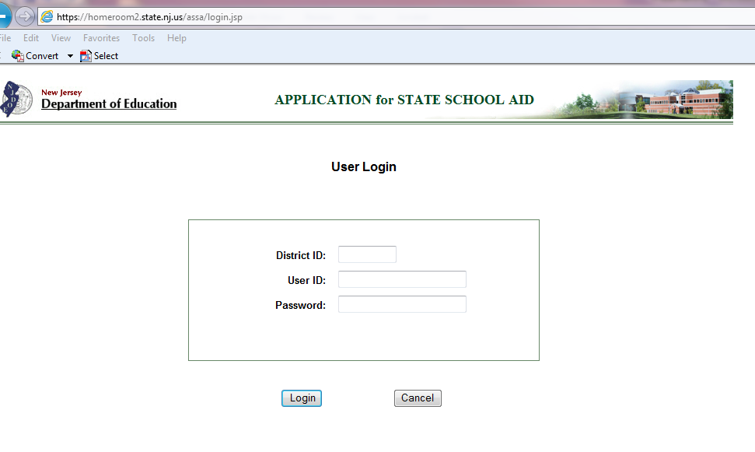
Application for State School Aid (ASSA) Software

Slide 2
ASSA Software Overview
Estimated Timeline
Software Features
ASSA Workpapers, Audit Documentation, and Instructions

Slide 3
ASSA – Timeline and Important Dates
Enrollment count date is 10/13.
October - Prepare Workpapers; Review NJ SMART Enrollment Report in NJ SMART prior to October 13.
Early November – ASSA system opens.
Sent/Received edits are live on the system.
Due Date is early December. Exact date to be announced later.

Slide 4
ASSA – Software Features
Web-based, accessed through the Homeroom.
Data entry screens.
Reports.
Preloaded enrollment data for On Roll, Sent, Received, Charters Schools, and State Facilities.
Instant send/receive edits.
Electronic certification.

Slide 5
ASSA – Homeroom
District’s Homeroom Administrator provides access to users responsible for data entry, review, and certification.
Username and passwords managed by school districts.
Data must be saved prior to leaving a page.

Slide 6
ASSA – Data Entry Menu
Data Entry tab includes On Roll, Sent, Received, On Roll Choice and Regional Enrollment Breakdown.

Slide 7
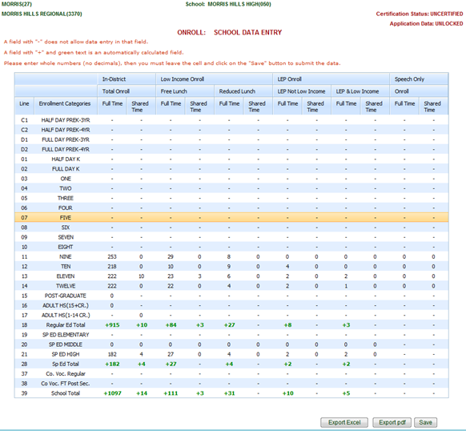
ASSA – Data Entry
Data entry screen after selecting a school or district.

Slide 8
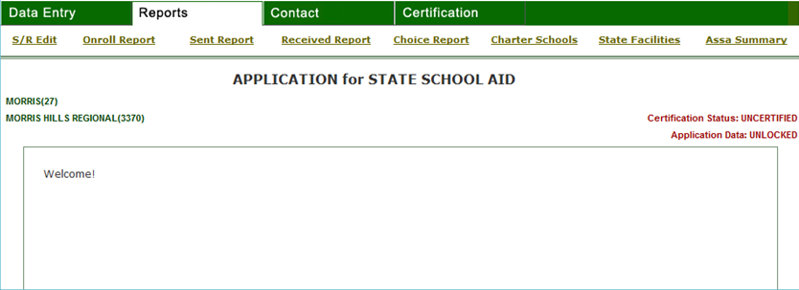
ASSA – Reports Menu
Reports tab includes Sent/Received Edits, On Roll, Sent, Received, Choice On Roll, Charter Schools, State Facilities, and ASSA Summary.

Slide 9
ASSA – Sent/Received Report
Includes instant sent/received edits

Slide 10
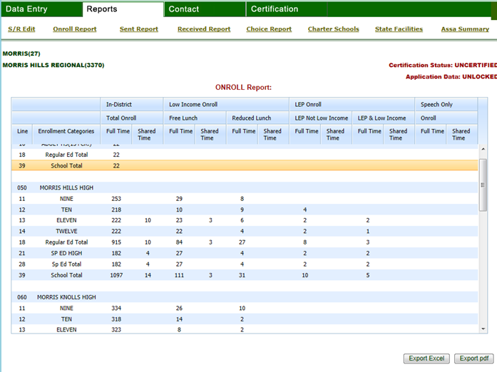
ASSA – On Roll Report

Slide 11
ASSA – Summary Report Features
Resident Enrollment
Errors
Certification Link

Slide 12
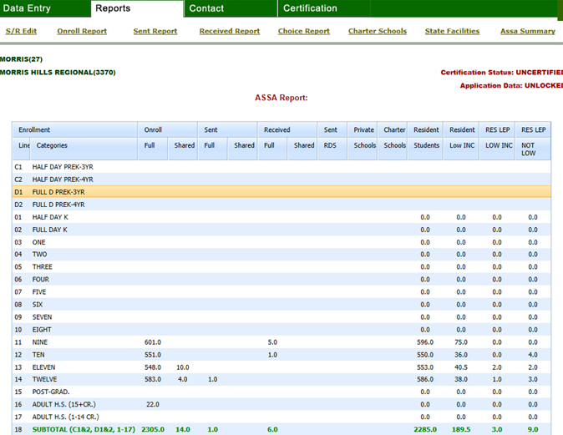
ASSA – Summary Report

Slide 13
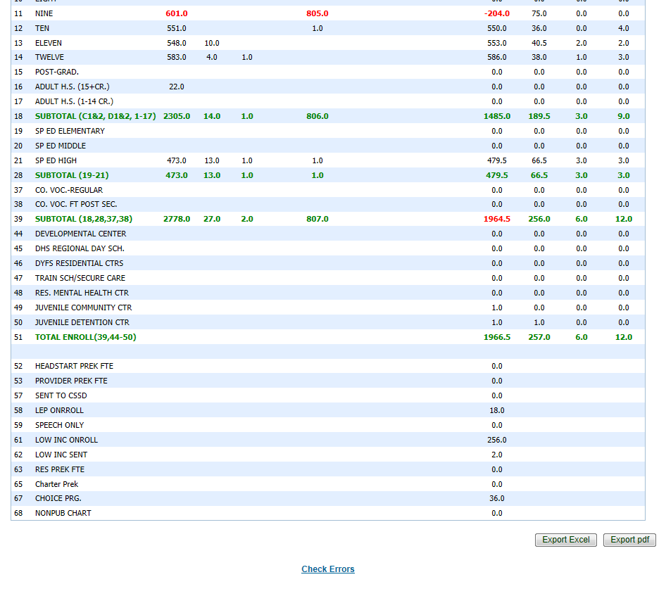
ASSA – Summary Report Errors

Slide 14
ASSA – Error Details

Slide 15
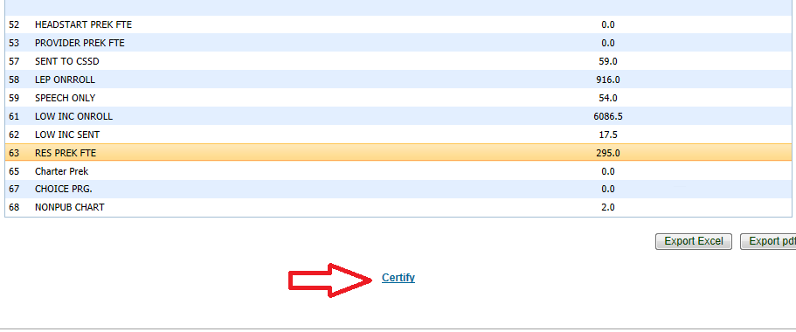
ASSA – Certify

Slide 16
District Web Enrollment Report in NJSMART
District Enrollment Report is a report included in NJSMART. It summarizes the current SID Management data that will be preloaded in the ASSA.
Prior to the NJSMART snapshot date of October 13, districts should log into NJSMART and view their district’s Enrollment Report.
All corrections in NJSMART must be made prior to the October 13 snapshot. After this date, any changes applicable to October 13 can only be made in the ASSA.

Slide 17
ASSA – Preloaded Enrollments
On Roll, Sent, Received, Choice On Roll, Charter School, and State Facilities enrollments are preloaded.
On Roll, Sent, Received, Choice On Roll are based on the October 13 NJSMART SID Management submission.
These enrollments can be modified in the ASSA.
Must “save” data for the enrollment to be updated.
Student records must have valid values in the district and school codes, grade levels, tuition codes, free/reduced lunch, special education classification, LEP dates, speech, municipal code, etc… to be used in the ASSA preload.

Slide 18
ASSA – Possible Preload Adjustments
Students that were not included on the October 13 NJSMART submission.
Students that were incorrectly reported in the NJSMART submission.
Add district-placed and district-paid public school special education students that are placed in nonpublic schools. Only students that are attending Approved Private Schools for Students with Disabilities (APSSDs) are preloaded. Students placed in schools that are not on this list must be Commissioner-approved placements or court ordered.
Adjust for shared-time students not attending a vocational district.

Slide 19
ASSA – Other Preloaded Enrollments
Charter school enrollments are based on the Charter School Enrollment system.
These enrollments cannot be modified in the ASSA.
State facilities enrollments are based on the enrollments submitted by the state facilities and the County Office district assignments in the State Facilities Enrollment System.
These enrollments cannot be modified in the ASSA.

Slide 20
ASSA – Workpapers and Instructions
Workpapers are required to be kept on file in the district.
Attendance register for October is required and must be kept on file in the district.
The manual is available on the Finance web page.

Slide 21
ASSA Help
All ASSA program and technical questions must be e-mailed to:
Office of School Finance
at
ASSA@doe.nj.gov
Next fiscal year’s state aid calculation will be based on the October 13 ASSA Collection.
Thank you!

