Slide 1
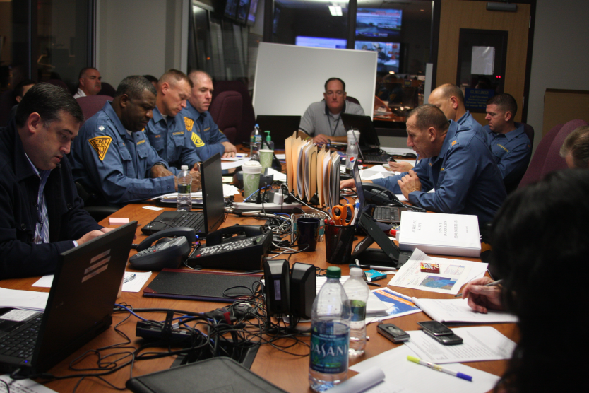
Working with State and Local Emergency Management Officials
Mary J. Goepfert, External Affairs Officer, NJOEM
lppgoepm@gw.njsp.org
609.963.6818

Slide 2
Topics Covered
Emergency management systems in NJ
Emergency Preparedness 101
Organizational disaster response, working with local officials

Slide 3
Emergency Management: Definition
Emergency Management is the discipline and profession of applying science, technology, planning and management to deal with extreme events that can injure or kill large numbers of people, do extensive damage to property, and disrupt community life.
Emergency Management is an all hazards approach to planning for disasters within a community.
Emergency Management brings together all areas of government, private sector, private non-profit sector, faith-based community to mitigate a crisis or local disaster.

Slide 4
Emergency Planning – 5 w’s
Who ? – (in NJ) NJ State Police/OEM, 21 counties, 565 municipalities
What ? – natural, technological, civil disasters
When ? – 4 phases of disaster: mitigation, preparedness, response and recovery
Where ? – everywhere: state, counties, municipalities, schools, hospitals, businesses, PNP’s
Why ? – Emergency planning saves lives, protects property, and the environment
How ? – use standard practices

Slide 5
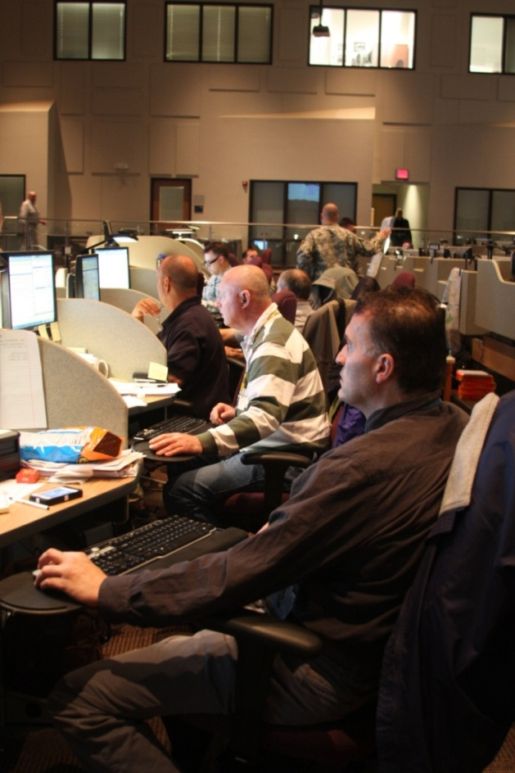
Emergency Management in NJ
Municipal
County
State
Federal
“bottom up” approach
“Phases” model: mitigation, preparedness, response, recovery, prevention

Slide 6
Model: Disaster Cycle

Slide 7
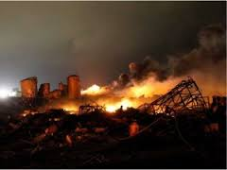
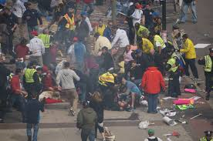
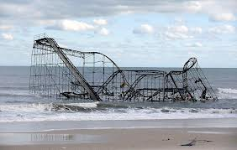
Types of Disasters
Natural
Technological
Civil

Slide 8
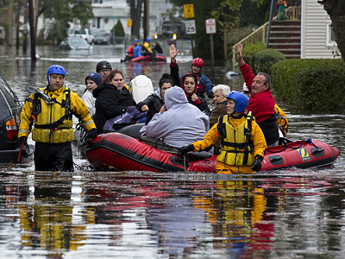
Community Impacts and Protective Actions
“Notice” vs. “No-Notice”
Power and utility
Debris
Road Closures
Property Damage
Death, injury
Evacuation
Shelter in Place
Closing
Emergency Services and Hospital - Surge

Slide 9
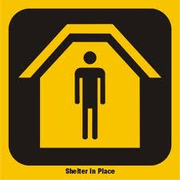
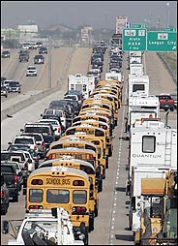
Protective Action Recommendations
Shelter-in-Place, “Lockdown”
Evacuation
How are you notified of these decisions ?

Slide 10
Term to Know: “State of Emergency”
Allows local authorities to deploy resources quickly
Can be local or statewide
Will be publicly announced, media, social media
Know: what is being asked of the public ? – e.g. don’t drive, curfews, sometimes no public actions are required

Slide 11
Action Step: Stay informed
Identify your local and county OEM Officials
www.ready.nj.gov – links to counties
Stay informed – opt in, connect, follow, “like”

Slide 12
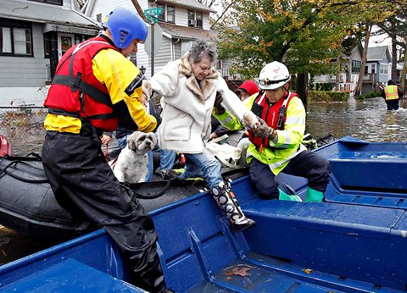
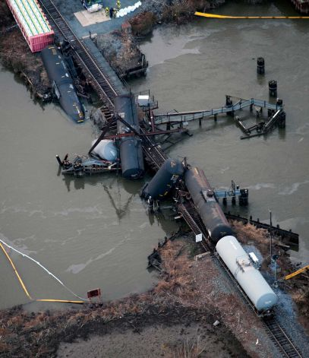
Potential Disasters – NJ
Identify where you might be vulnerable – your local Office of Emergency Management can help

Slide 13
Second Step - Facilities: Mitigate Risk
Structural – clear debris, secure shelves, maintain properties, explore generator for back-up power.
Prepare to shelter in place: water, non-perishable food/snacks, secure area in the event of tornadic activity
Resources for evacuation – insure people with mobility impairments can exit – evac chairs or assigned staff
Would staff need to stay overnight ? What is needed to support this ?

Slide 14
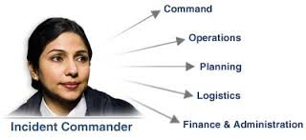
Incident Command System
“Incident Commander” leads field response. What about your organization – who will interface with emergency responders ?

Slide 15
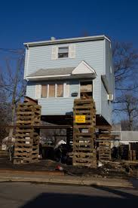
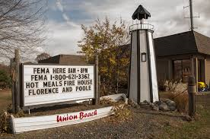
Disaster Recovery
Work with the larger community, not just emergency responders
Long term recovery – centralized systems
FEMA’s role regarding disaster survivors
Physical recovery – injuries, debris, mold, repairs

Slide 16
Emergency Preparedness 101
Stay Informed (“Connect” handout)
72 hour kit
Family Plan
Barriers to preparedness
Consider Disability, Chronic Illness

Slide 17
Thank you !

