Slide 1
New Jersey Department of Transportation
New Jersey Society of Municipal Engineers
General Membership Meeting
Edison, New Jersey
February 8, 2017

Slide 2
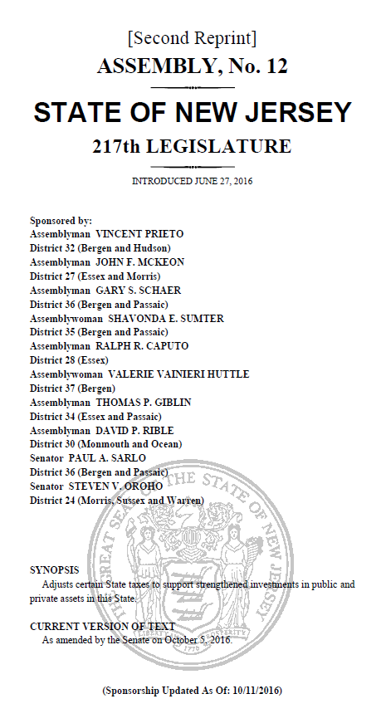
TTF Reauthorization- Aid to Counties and Municipalities
$400 million legislated
Municipal Aid-$150 million
Includes $10 million in Urban Aid
County Aid-$150 million
Local Bridge Fund-$44 million
Local Aid Infrastructure Fund
$7.5 million LAIF, Discretionary
$ 20.5 million, State Transportation Infrastructure Bank Fund
Local Freight Impact Fund-$28 million

Slide 3
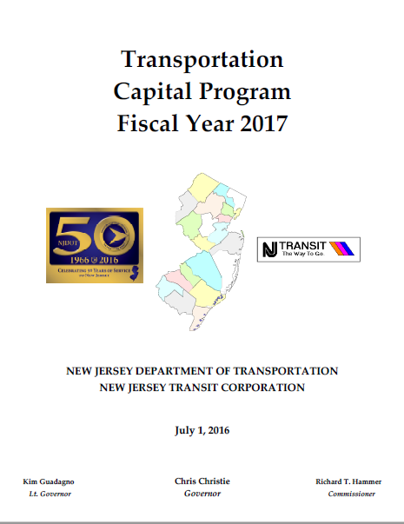
Funding Levels
Funding appropriated for FY 2017 State Aid Programs at pre-existing levels
FY 2018 Programs to be funded at levels established in the TTF Reauthorization

Slide 4
FY 2017 & FY 2018 STATE AID PROGRAMS

Slide 5
FY 2017 Federal Aid Programs
Safe Routes to School - $5.6 M
Transportation Alternatives - $13.2M
Local Safety High/Risk Rural Roads Program $20 M
Local CMAQ Initiative $7.9M
MPO Local Lead Program (STP/State) $90M

Slide 6
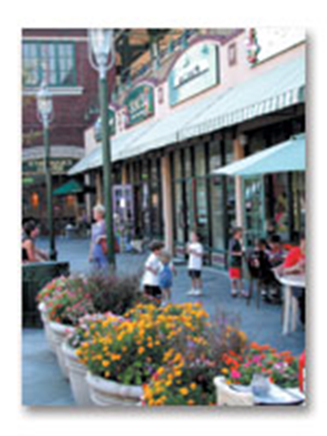
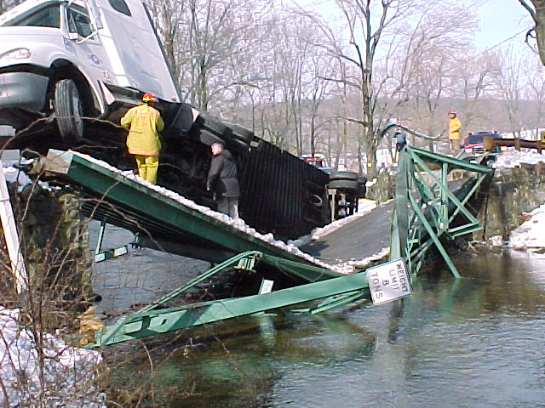
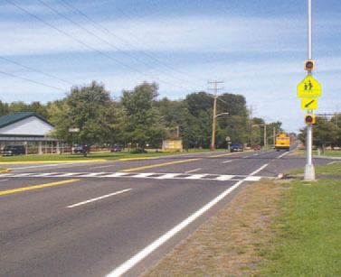
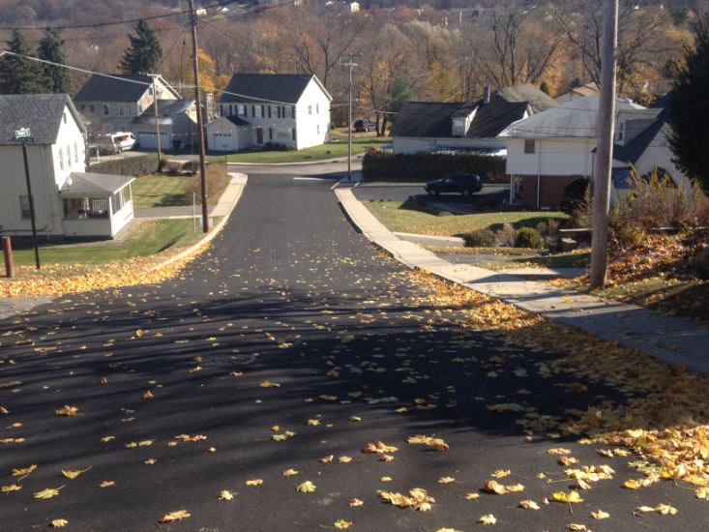
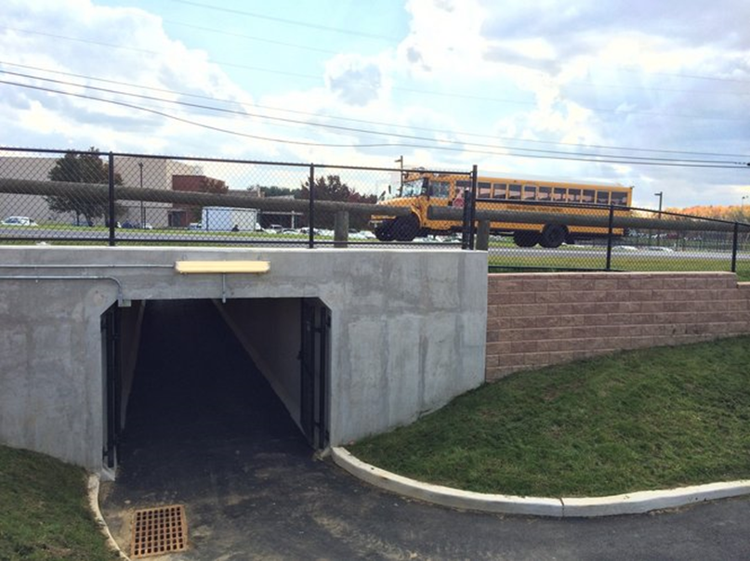
Local Aid Program Schedules
2016 SRTS Grant Announcements
SJTPO & DVRPC-February 2017
NJTPA-March 2017
Transportation Alternatives Program
Application deadline-November 2016
Application review –February 2017
Grant announcements-April 2017
Municipal Aid
Application deadline-February 3, 2017
Application review- April 2017
Screening Committee-May 2017
Grant announcements-June 2017
Bikeway, Transit Village, & Safe Streets to Transit
Application deadline-February 3, 2017
Application review-April 2017
Announcements-June 2017
Local Bridge
Application deadline-March 29, 2017
Application review-June 2017
Announcements-July 2017
Highway Safety Program
Application deadline-February 20, 2017
Execute agreements-June 2017

Slide 7
TTF Shutdown Recovery Plan
NJDOT will make available funds for reasonable costs associated with safely shutting down and securing projects affected by EO 210
NJDOT will also make available funds for reasonable costs associated with accelerating projects affected by EO 210
Grant recipients are required to certify the reasonableness of the costs and release the State of any claims and liabilities arising under the grant agreement

Slide 8
Action Items
Schedule annual meeting with NJSME
Establish program criteria for Freight Impact Fund
Review program criteria for Local Bridge Fund

Slide 9
http://www.state.nj.us/transportation/business/localaid/

Slide 10
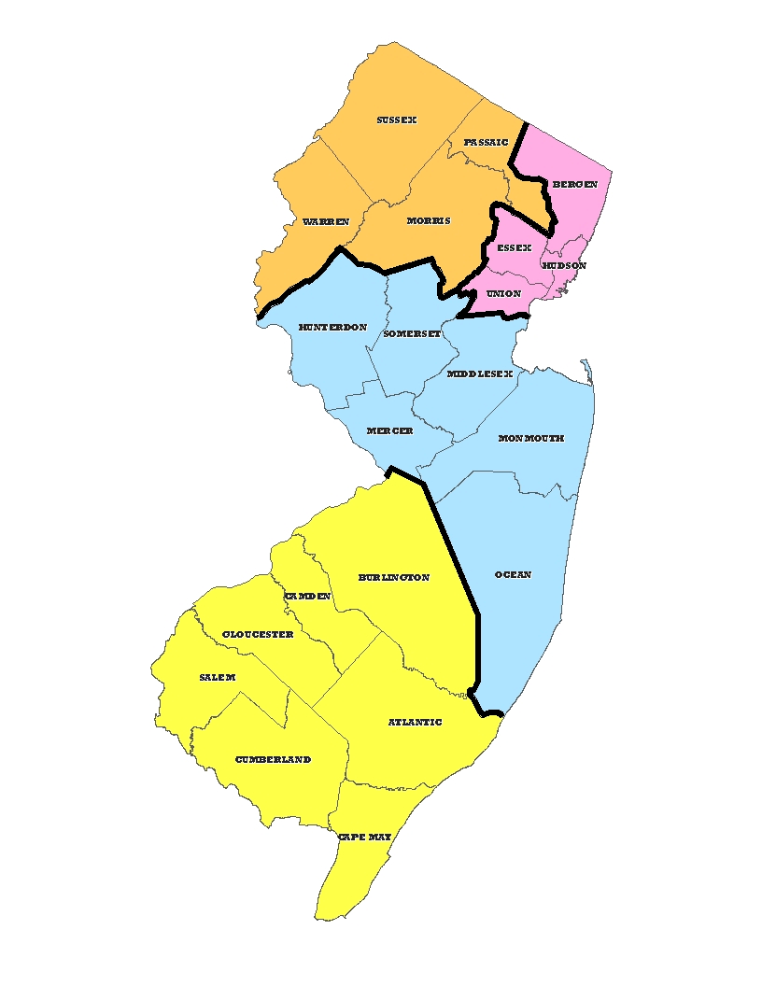
New Jersey Department of Transportation Local Aid and Economic Development
District 2
Richard Loveless
Eileen Schack
153 Halsey Street, 5th Floor
Newark, NJ 07102
973.877.1500
FAX: 973.648-4547
District 1
Joseph Birchenough
Roxbury Corporate Center
200 Stierli Court
Mount Arlington, NJ 07856
973.601.6700
FAX: 973.601.6709
District 3
Dominick Critelli
1035 Parkway Ave
Trenton, NJ 08625
609.530.5271
FAX: 609.530.8044
District 4
Salim Mikhael
1 Executive Campus
Route 70 West
Cherry Hill, NJ 08002
856.486.6618
FAX: 856.486.6771
Main Office
Michael Russo
1035 Parkway Avenue
Trenton, NJ 08625-06000
609.530.3640
FAX: 609.530.8044

