Slide 1
AchieveNJ: Principal and Assistant/ Vice Principal Evaluation Scoring Guide

Slide 2
Overview
This presentation provides information on how districts compile evaluation ratings for principals, assistant principals (APs), and vice principals (VPs) in AchieveNJ.
Each element of the evaluation results in a 1 - 4 rating, which is weighted according to state formulas shown in later slides.
Overviews and examples are provided for scoring each of the multiple measures.
The presentation concludes with information on using each of the multiple measure ratings to calculate one final summative evaluation score for each principal/AP/VP.

Slide 3
Multiple Measures for Principals/APs/VPs
Administrators are evaluated based on the following measures.
Practice
Student Achievement
Principal Practice
Observation Instrument
Evaluation Leadership Instrument (optional)
SGO Average
Average of teacher SGOs
Admin. Goals
Set towards measure of student achievement
mSGP
Median of school-wide SGP scores
Summative Rating
Overall Evaluation Score
All principals/APs/VPs
Only those in schools with SGP grades receive this score

Slide 4
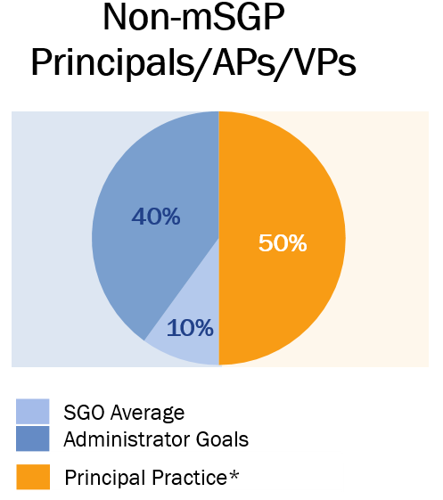
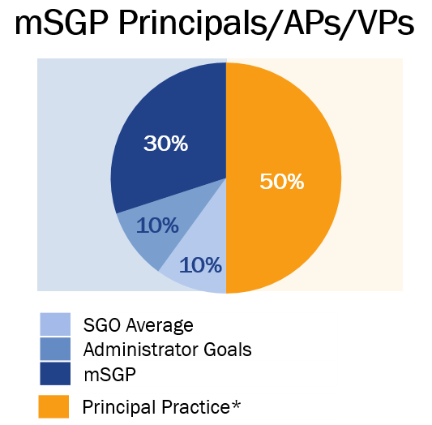
Component Weighting
As shown above, weights for each measure depend on the SGP status of the administrator.
*The principal practice score may include results from both, the district’s state-approved principal practice instrument and the optional evaluation leadership instrument.
Notes:
5 Measures:
Observations
Schoolwide Student Growth Percentiles
Schoolwide Student Growth Objectives
School-specific achievement goals
Evaluation leadership
Grades Number % of NJ Schools Grades w/ SGP Principal Classification
Pre K, K – 5 ~700 28% 2 of 6 SGP
Pre K, K – 4 ~190 7.5% 1 of 5
Pre K, K – 3 ~350 14% 0 of 4
Pre K, K – 8 ~400 16% 5 of 9 SGP
4,5,6 -8 ~400 16% 3 of 3 SGP
9-12 ~400 16% 0 of 4
Single Grade (5-8) ~10 < 1% 1 of 1 SGP*
Ed Services Schools ~50 2% 0
TOTAL 2500 100% -
*SGP will apply to single grade schools

Slide 5
Principal Practice Scoring
Principal practice is measured according to a district-chosen observation instrument, such as Marzano, McREL, etc… (see here for complete list).
Local school districts have discretion on how to create a final principal practice rating on a 1 – 4 scale.
The example that follows show how different components of the principal practice instrument might be calculated. This is an example, not a recommendation. Please consult your District Evaluation Advisory Committee (DEAC) to inquire how this is being done locally.

Slide 6
Principal Practice: Weighting of Practice Instrument Domains and Components
Many principal practice evaluation instruments (or some standards or domains within those instruments) rely on evidence collection throughout the year and do not score until the summary conference on each individual component of the instrument.
Example (Sample score below each domain):
Knowledge
Planning
Delivery
Assessment
Environment
Professional Responsibility
18.25
3.25
4
3
2
2.75
3.25
18.25/6 = 3.04

Slide 7
*Evaluation Leadership Scoring
Principals may be rated on their effectiveness in implementing AchieveNJ at the school level using the State Evaluation Leadership Instrument, which includes the following domains for principals (and only those in Domain 2 for APs/VPs):
Domain 1: Building Knowledge and Collaboration | Domain 2: Executing the Evaluation System Successfully
Component 1a: Preparing teachers for success Component 1b: Building collaboration | Component 2a: Fulfilling requirements of the evaluation system Component 2b: Providing feedback, coaching, and planning for growth Component 2c: Ensuring reliable, valid observation results Component 2d: Ensuring high-quality SGOs
Local districts have discretion to determine a 1 – 4 rating for Evaluation Leadership based on the components described in each instrument and whether this will be included in the summative evaluation of the leader.
*The Evaluation Leadership rubric score may be used as an optional component of principal practice

Slide 8
Student Growth Objective (SGO) Scoring
Administrators are rated on their teachers’ SGO performance each year through a calculated average of teachers’ SGO scores. See the example below:
Teachers | SGO Score*
Teacher 1 | 3.5
Teacher 2 | 2.5
Teacher 3 | 3
Teacher 4 | 3
Teacher 5 | 2
Average of SGO scores | 3
SGO Average for Principal/AP/VP: 15/5 = 3

Slide 9
Administrator Goal Scoring
In consultation with the superintendent, a principal/AP/VP sets between 1 - 4 achievement goals for the students in his/her building (Administrator Goals), using measures such as:
Advanced Placement scores
SAT, ACT scores
College acceptance rates
HSPA scores
Annual measurable objectives (AMOs)
Graduation rates (in schools under 80 percent)
Nationally norm-referenced tests
Local districts have discretion to determine the total number of goals each administrator sets. The average score among the total number of Administrator Goals for each administrator should be calculated to determine the final rating.
See the following slides for scoring examples and refer to this Administrator Goal-Setting Template for a form and example goals shown on a 1 - 4 scale.

Slide 10
Administrator Goal Scoring Example (slide 2 of 2)
Administrator Goal
340 students (40 more than last year) will successfully complete an AP course as measured by: A score of 3, 4, or 5 on the AP test and A course grade of C or better.
Scoring Plan
Target Score | Exceptional (4) | Full (3) | Partial (2) | Insufficient (1)
Score of 3-5 on AP exam Course grade of C or better | Greater than 345 students | 335-345 | 310-334 | Less than 310

Slide 11
Administrator Goal Scoring Example (slide 2 of 2)
Administrator Goal
90% of kindergarten students will grow at least 12 sounds at each administration (winter and spring) of the Dynamic Indicators of Basic Early Literacy Skills (DIBELS) or reach 25 sounds per minute by the end of the school year.
Scoring Plan
Target Score | Exceptional (4) | Full (3) | Partial (2) | Insufficient (1)
Increase 12 sounds at each DIBELS or 25 sounds/minute by end of year | Greater than 94% | 87%-94% | 75-86% | Less than 75%

Slide 12
Student Growth Percentile (SGP) Scoring
Median Student Growth Percentile (mSGP) scores provided by the Department will be translated from a 1 – 99 into a 1 - 4 score according to the conversion chart below and then used in a summative rating.
mSGP Score | Evaluation Rating
1 – 20 | 1.0
21 | 1.1
22 | 1.2
23 | 1.3
24 | 1.4
25 | 1.5
26 | 1.6
27 | 1.7
28 | 1.8
29 | 1.9
30 | 2.0
31 | 2.1
32 | 2.2
33 | 2.3
34 | 2.4
mSGP Score | Evaluation Rating
35 | 2.5
36 | 2.5
37 | 2.6
38 | 2.6
39 | 2.7
40 | 2.7
41 | 2.8
42 | 2.8
43 | 2.9
44 | 2.9
45 | 3.0
46 | 3.0
47 | 3.0
48 | 3.0
49 | 3.0
mSGP Score | Evaluation Rating
50 | 3.0
51 | 3.0
52 | 3.0
53 | 3.0
54 | 3.0
55 | 3.0
56 | 3.1
57 | 3.1
58 | 3.2
59 | 3.2
60 | 3.3
61 | 3.3
62 | 3.4
63 | 3.4
64 | 3.4
mSGP Score | Evaluation Rating
65 | 3.5
66 | 3.5
67 | 3.5
68 | 3.6
69 | 3.6
70 | 3.6
71 | 3.7
72 | 3.7
73 | 3.7
74 | 3.8
75 | 3.8
76 | 3.8
77 | 3.9
78 | 3.9
79 | 3.9
80 - 99 | 4.0
The Department will provide individual school mSGP scores for districts as they become available in the following year.

Slide 13
SGP Conversion Chart Explained
mSGP Score | Evaluation Rating
35 | 2.5
36 | 2.5
37 | 2.6
38 | 2.6
39 | 2.7
40 | 2.7
41 | 2.8
42 | 2.8
43 | 2.9
44 | 2.9
45 | 3.0
46 | 3.0
47 | 3.0
48 | 3.0
49 | 3.0
50 | 3.0
51 | 3.0
52 | 3.0
53 | 3.0
54 | 3.0
55 | 3.0
56 | 3.1
57 | 3.1
58 | 3.2
59 | 3.2
60 | 3.3
61 | 3.3
62 | 3.4
63 | 3.4
64 | 3.4
Why are all the values between 45 and 55 set to the same score (3.0)?
The Department believes that educators in the middle of the mSGP distribution are driving significant academic growth in their students.
Educators whose students achieve scores in this range should be recognized by receiving a rating on par with their impact.

Slide 14
mSGP Conversion Chart Explained (slide 1 of 2)
mSGP Score | Evaluation Rating
1 – 20 | 1.0
21 | 1.1
22 | 1.2
23 | 1.3
24 | 1.4
25 | 1.5
26 | 1.6
27 | 1.7
28 | 1.8
29 | 1.9
30 | 2.0
31 | 2.1
32 | 2.2
33 | 2.3
34 | 2.4
Why are the values at the extreme ends of the distribution, 1-20 = 1 in this case (and 80-99 = 4), set to the same score?
When more than half of an educator’s students are in the top 20 percentile points on the SGP scale it is an indication of very high growth.
When more than half of an educator’s students are in the bottom percentile points this is an indicator of low growth to be considered with other evidence.
mSGP Score | Evaluation Rating
65 | 3.5
66 | 3.5
67 | 3.5
68 | 3.6
69 | 3.6
70 | 3.6
71 | 3.7
72 | 3.7
73 | 3.7
74 | 3.8
75 | 3.8
76 | 3.8
77 | 3.9
78 | 3.9
79 | 3.9
80 - 99 | 4.0

Slide 15
mSGP Conversion Chart Explained (slide 2 of 2)
mSGP Score | Evaluation Rating
65 | 3.5
66 | 3.5
67 | 3.5
68 | 3.6
69 | 3.6
70 | 3.6
71 | 3.7
72 | 3.7
73 | 3.7
74 | 3.8
75 | 3.8
76 | 3.8
77 | 3.9
78 | 3.9
79 | 3.9
80 - 99 | 4.0
Why Decimals? Why Tenths?
The use of decimals instead of whole numbers enables the scale to increase/decrease gradually, improving the statistical efficiency of the conversion.
This prevents large rating differences that may not accurately reflect significant differences in student learning.

Slide 16
Scoring the Summative Rating
This section describes scoring for the final summative rating.
Practice
Student Achievement
Principal Practice
Observation Instrument
Evaluation Leadership Instrument (optional)
SGO Average
Average of teacher SGOs
Admin. Goals
Set towards measure of student achievement
mSGP
Median of school-wide SGP scores
Summative Rating
Overall Evaluation Score
All principals/APs/VPs
Only those in schools with SGP grades receive this score

Slide 17
Summary of Process and Cut Scores
Setting Cut Scores
In the summer of 2013, approximately 90 educators from across New Jersey worked for three days analyzing data and making contributions to the summative rating scales.
Educators examined anonymous sample portfolios to review results from SGOs, observation ratings, and, where applicable, SGP data.
The educators recommended the cut scores below, which the Department has chosen to adopt in full from the standard-setting committee.
Ineffective | Partially Effective | Effective | Highly Effective
1.0 | 1.85 | 2.65 3.5 | 4.0

Slide 18
Summative Rating Example (Non-mSGP Administrator) (slide 1 of 3)
Example 1: Highly Effective Principal/AP/VP
Component | Raw Score | Weight | Weighted Score
Principal Practice | 3.75 | 0.3 | 1.125
Evaluation Leadership | 3.5 | 0.2 | 0.7
Student Growth Objective | 3.25 | 0.1 | 0.325
Administrator Goals | 3.5 | 0.4 | 1.4
Sum of the Weighted Scores |  |  | 3.55
3.55
Ineffective | Partially Effective | Effective | Highly Effective
1.0 | 1.85 | 2.65 3.5 | 4.0

Slide 19
Summative Rating Example (Non-mSGP Administrator) (Slide 2 of 3)
Example 2: Effective Principal/AP/VP
Component Scores | Raw Scores | Weights | Weighted Score
Principal Practice | 3.4 | 0.3 | 1.02
Evaluation Leadership | 3 | 0.2 | 0.6
Student Growth Objective | 3.7 | 0.1 | 0.37
Administrator Goals | 3.6 | 0.4 | 1.44
Sum of the Weighted Scores |  |  | 3.43
3.43
Ineffective | Partially Effective | Effective | Highly Effective
1.0 | 1.85 | 2.65 3.5 | 4.0

Slide 20
Summative Rating Example (Non-mSGP Administrator) (slide 3 of 3)
Example 3: Partially Effective Principal/AP/VP
Component | Raw Score | Weight | Weighted Score
Principal Practice | 2 | 0.3 | 0.6
Evaluation Leadership | 2.5 | 0.2 | 0.5
Student Growth Objective | 2.8 | 0.1 | 0.28
Administrator Goals | 2.5 | 0.4 | 1
Sum of the Weighted Scores |  |  | 2.38
2.38
Ineffective | Partially Effective | Effective | Highly Effective
1.0 | 1.85 | 2.65 3.5 | 4.0

Slide 21
Summative Rating Example (mSGP Administrator) (Slide 1 of 3)
Example 1: Highly Effective Principal/AP/VP
Component | Raw Score | Weight | Weighted Score
Principal Practice | 3.75 | 0.3 | 1.125
Evaluation Leadership | 3.5 | 0.2 | 0.7
Median Student Growth Percentile *65 | 3.5 | 0.1 | 0.35
Student Growth Objective | 3.25 | 0.1 | 0.325
Administrator Goals | 3.5 | 0.3 | 1.05
Sum of the Weighted Scores |  |  | 3.55
3.55
Ineffective | Partially Effective | Effective | Highly Effective
1.0 | 1.85 | 2.65 3.5 | 4.0

Slide 22
Summative Rating Example (mSGP Administrator) (slide 2 of 3)
Example 2: Effective Principal/AP/VP
Component Scores | Raw Scores | Weights | Weighted Score
Principal Practice | 3.4 | 0.3 | 1.02
Evaluation Leadership | 3 | 0.2 | 0.6
Median Student Growth Percentile *57 | 3.1 | 0.1 | 0.31
Student Growth Objective | 3.7 | 0.1 | 0.37
Administrator Goals | 3.6 | 0.3 | 1.08
Sum of the Weighted Scores |  |  | 3.38
3.38
Ineffective | Partially Effective | Effective | Highly Effective
1.0 | 1.85 | 2.65 3.5 | 4.0

Slide 23
Summative Rating Example (mSGP Administrator) (slide 3 of 3)
Example 3: Partially Effective Principal/AP/VP
Component | Raw Score | Weight | Weighted Score
Principal Practice | 2 | 0.3 | 0.6
Evaluation Leadership | 2.5 | 0.2 | 0.5
Median Student Growth Percentile *57 | 3.1 | 0.1 | 0.31
Student Growth Objective | 2.8 | 0.1 | 0.28
Administrator Goals | 2.5 | 0.3 | 0.75
Sum of the Weighted Scores |  |  | 2.44
2.44
Ineffective | Partially Effective | Effective | Highly Effective
1.0 | 1.85 | 2.65 3.5 | 4.0

Slide 24
FIND OUT MORE:
AchieveNJ Website educatorevaluation@doe.state.nj.us
609-376-3974

